Slide 1
DISORDERS OF CALCIUM
Dr. ARUN R NAIR
ASSISTANT PROFESSOR, SKHMC

Slide 2
CALCIUM
PHYSIOLOGY

Slide 3
The parathyroid hormone (PTH), secreted by the parathyroid glands, is responsible for regulating blood calcium levels; it is released whenever blood calcium levels are low.
PTH increases blood calcium levels by stimulating osteoclasts, which break down bone to release calcium into the blood stream.
PTH increases blood calcium levels by increasing the amount of calcium resorbed by the kidneys before it can be excreted in the urine.
PTH increases blood calcium levels by triggering the formation of calcitriol, which increases absorption of dietary calcium through the intestines.

Slide 4
Calcitonin, a hormone produced by the thyroid, acts in opposition to PTH by inhibiting osteoclasts, stimulating osteoblasts, and increasing excretion of calcium into the urine by the kidneys.
Distribution

Slide 5
Different forms of Calcium
Most of the calcium in the body exists as the mineral hydroxyapatite, Ca₁₀(PO₄)₆(OH)₂.
Calcium in the plasma:
45% in ionized form (the physiologically active form)
45% bound to proteins (predominantly albumin)
10% complexed with anions (citrate, sulfate, phosphate)
Both total calcium and ionized calcium measurements are available in many laboratories

Slide 6
Body requirements
Age (in years) 1 – 3
4 - 8
9 - 18
19 - 50
51+
Calcium Requirement 500mg
800mg 1300mg 1000mg 1500mg
Pregnant and lactating women are recommended a daily calcium intake of 1000mg.

Slide 7
About 99% of the body’s calcium is stored in the bones, but cells (particularly muscle cells) and blood also contain calcium. Calcium is essential for the following:
Formation of bone and teeth
Muscle contraction
Normal functioning of many enzymes
Blood clotting
Normal heart rhythm

Slide 8
Calcium-rich foods
People can obtain calcium from a range of foods and drinks.
The following are good sources:
yogurt
milk
fortified dairy alternatives, such as soy milk
sardines and salmon
cheese
tofu
green leafy vegetables, such as broccoli, turnip leaves, watercress, and kale
many fortified breakfast cereals
fortified fruit juices
nuts and seeds, especially almonds, sesame, legumes and grains
cornmeal and corn tortillas

Slide 9
Hormonal Control of Blood Calcium Levels
Regulation of blood calcium concentrations is important for generation of muscle contractions and nerve impulses, which are electrically stimulated.
If calcium levels get too high, membrane permeability to sodium decreases and membranes become less responsive.
If calcium levels get too low, membrane permeability to sodium increases and convulsions or muscle spasms may result.

Slide 10
Hormonal Control of Blood Calcium Levels
Blood calcium levels are regulated by parathyroid hormone (PTH), which is produced by the parathyroid glands.
PTH is released in response to low blood calcium levels.
It increases calcium levels by targeting the skeleton, the kidneys, and the intestine.
In the skeleton, PTH stimulates osteoclasts, which are cells that cause bone to be reabsorbed, releasing calcium from bone into the blood.
PTH also inhibits osteoblasts, cells which deposit bone, reducing calcium deposition in bone.
In the intestines, PTH increases dietary calcium absorption and in the kidneys, PTH stimulates re-absorption of the calcium.

Slide 11
Hormonal Control of Blood Calcium Levels
While PTH acts directly on the kidneys to increase calcium re-absorption, its effects on the intestine are indirect.
PTH triggers the formation of calcitriol, an active form of vitamin D, which acts on the intestines to increase absorption of dietary calcium.
PTH release is inhibited by rising blood calcium levels.

Slide 12
Hormonal Control of Blood Calcium Levels
Hyperparathyroidism results from an overproduction of PTH, which leads to excessive amounts of calcium being removed from bones and introduced into blood circulation.
This may produce structural weakness of the bones, which can lead to deformation and fractures, plus nervous system impairment due to high blood calcium levels.
Hypoparathyroidism, the underproduction of PTH, results in extremely low levels of blood calcium, which causes impaired muscle function and may result in tetany (severe sustained muscle contraction).

Slide 13
Hormonal Control of Blood Calcium Levels
The hormone calcitonin, which is produced by the parafollicular (or C) cells of the thyroid, has the opposite effect on blood calcium levels as PTH.
Calcitonin decreases blood calcium levels by inhibiting osteoclasts, stimulating osteoblasts, and stimulating calcium excretion by the kidneys.
This results in calcium being added to the bones to promote structural integrity.

Slide 14
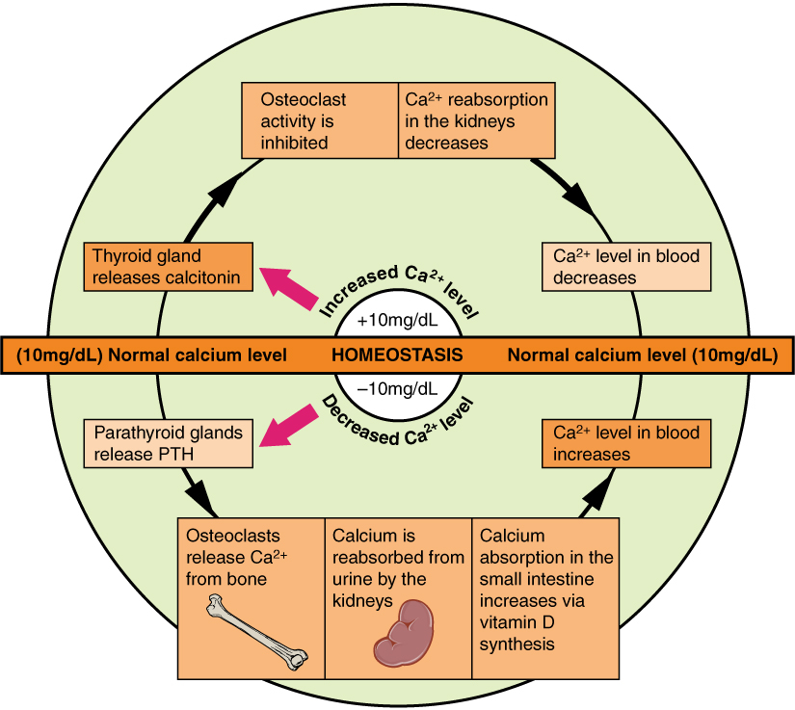
Hormonal Control of Blood Calcium Levels

Slide 15
CALCIUM
DISORDERS

Slide 16
Hypercalcaemia

Slide 17
Pathophysiology and causes
The major causes of hypercalcaemia are primary hyperparathyroidism and malignancies are by far the most common (>90% of cases).
Hyperparathyroidism itself may be primary, secondary or tertiary.
Primary hyperparathyroidism is caused by single (>80%) parathyroid adenomas or by diffuse hyperplasia of all the glands (15–20%); multiple parathyroid adenomas are rare.
Involvement of multiple parathyroid glands may be part of a familial syndrome (e.g. multiple endocrine neoplasia (MEN) syndrome type 1 or 2a).

Slide 18
Parathyroid carcinoma is rare (<1%), though it usually produces severe and intractable hypercalcaemia.
Hyperparathyroidism-jaw tumour syndrome is a rare familial cause of hyperparathyroidism which may be associated with parathyroid carcinoma and maxillary or mandibular tumours.

Slide 19
Causes of hypercalcaemia
Excessive parathormone (PTH) secretion
Primary hyperparathyroidism (commonest by far), adenoma (common), hyperplasia or carcinoma (rare), Tertiary hyperparathyroidism, Ectopic PTH secretion (very rare indeed)
Malignant disease – low PTH levels (second commonest cause)
Myeloma, Secondary deposits in bone, Production of osteoclastic factors by tumours, PTH-related protein secretion
Excess action of vitamin D
Iatrogenic or self-administered excess, Granulomatous diseases, e.g. sarcoidosis, TB, Lymphoma

Slide 20
Excessive calcium intake
‘Milk-alkali’ syndrome
Other endocrine disease (mild hypercalcaemia only)
Thyrotoxicosis
Addison’s disease
Miscellaneous
Long-term immobility, Familial hypocalciuric hypercalcaemia.

Slide 21
Mild hypercalcaemia is frequently asymptomatic, but more severe hypercalcaemia can produce a number of symptoms:
General. There may be tiredness, malaise, dehydration and depression.
Renal. Renal colic from stones, polyuria or nocturia, haematuria and hypertension occurs. The polyuria results from the effect of hypercalcaemia on renal tubules, reducing their concentrating ability – a form of mild nephrogenic diabetes insipidus. Primary hyperparathyroidism is present in about 5% of patients who present with renal calculi.
Abdomen. There may be abdominal pain.
Chondrocalcinosis and ectopic calcification. These are occasional features.

Slide 22
Bones. There may be bone pain. Hyperparathyroidism mainly affects cortical bone, and bone cysts and locally destructive ‘brown tumours’ occur but only in advanced disease. Only 5–10% of all cases have definite bony lesions even when sought. Bone disease may be more apparent when there is co-existing vitamin D deficiency.
Corneal calcification. This is a marker of longstanding hypercalcaemia but causes no symptoms.
Severe hypercalcaemia (>3 mmol/L) is usually associated with malignant disease, hyperparathyroidism, chronic kidney disease or vitamin D therapy.

Slide 23
Investigations and differential diagnosis
Biochemistry - Several fasting serum calcium and phosphate samples should be performed.
Serum PTH. The hallmark of primary hyperparathyroidism is hypercalcaemia and hypophosphataemia with detectable or elevated intact PTH levels during hypercalcaemia.
When this combination is present in an asymptomatic patient then further investigation is usually unnecessary.
Hyperchloraemic acidosis – often mild.
Renal function is usually normal but should be measured as a baseline.

Slide 24
Hypocalcaemia

Slide 25
Hypocalcemia:
Total serum calcium concentration < 8.5 mg/dL (< 2.12 mmol/L), or ionized (free) calcium concentration < 4.65 mg/dL (< 1.16 mmol/L).

Slide 26
Causes of Hypocalcemia
Inadequate vitamin D production and action
Nutritional deficiency
Lack of sunlight exposure
Malabsorption
Post-gastric bypass surgery
End-stage liver disease and cirrhosis
Chronic kidney disease
Vitamin D-dependent rickets type 1 and type 2

Slide 27
Inadequate PTH production/Hypoparathyroidism
Functional hypoparathyroidism
Magnesium depletion
Magnesium excess
PTH resistance - Pseudohypoparathyroidism
Miscellaneous etiologies
Neonatal hypocalcemia
Hyperphosphatemia
Phosphate retention in acute or chronic renal failure
Excess phosphate absorption caused by enemas, oral supplements

Slide 28
Massive phosphate release caused by tumor lysis or crush injury
Rapid transfusion of large volumes of citrate-containing blood
Acute critical illness “Hungry bone syndrome”
Post-thyroidectomy for Grave’s disease
Post-parathyroidectomy
Osteoblastic metastases
Acute pancreatitis
Rhabdomyolysis
Mitochondrial gene defects

Slide 29
Neuromuscular irritability
Chvostek's sign
Trousseau's sign
Paresthesias
Tetany
Seizures (focal, petit mal, grand mal)
Muscle cramps
Muscle weakness
Laryngospasm
Bronchospasm

Slide 30
Neurological signs and symptoms
Extrapyramidal signs due to calcification of basal ganglia
Calcification of cerebral cortex or cerebellum
Personality disturbances
Irritability
Impaired intellectual ability
Nonspecific EEG changes
Increased intracranial pressure
Parkinsonism
Choreoathetosis
Dystonic spasms

Slide 31
Mental status
Confusion
Disorientation
Psychosis
Fatigue
Anxiety
Poor memory
Reduced concentration
Enamel hypoplasia
Shortened premolar roots
Thickened lamina dura
Delayed tooth eruption
Increased dental caries
Atopic eczema
Exfoliative dermatitis
Psoriasis
Impetigo herpetiformis
Alopecia
Ectodermal changes
Dry skin
Coarse hair
Brittle nails

Slide 32
Smooth muscle involvement
Dysphagia
Abdominal pain
Biliary colic
Dyspnea
Wheezing
Ophthalmologic manifestations
Subcapsular cataracts
Papilledema

Slide 33
Cardiac
Prolonged QT interval on EKG
Congestive heart failure
Cardiomyopathy

Slide 34
The hallmark of acute hypocalcemia is neuromuscular irritability.
Patients often complain of numbness and tingling in their fingertips, toes, and the perioral region.
Paresthesias of the extremities may occur, along with fatigue and anxiety.
Muscle cramps can be very painful and progress to carpal spasm or tetany.
In extreme cases of hypocalcemia, bronchospasm and laryngospasm with stridor may occur.

Slide 35
Muscle symptoms can be so severe as to present with a polymyositis-like picture with elevated muscle isoenzymes.
These symptoms are corrected by calcium replacement. Clinically, neuromuscular irritability can be demonstrated by eliciting Chvostek's or Trousseau's signs.
Chvostek's sign is elicited by tapping the skin over the facial nerve anterior to the external auditory meatus. Ipsilateral contraction of the facial muscles occurs in individuals with hypocalcemia. present in 10% of normal individuals.

Slide 36
Trousseau's sign is elicited by inflation of a blood pressure cuff to 20 mm Hg above the patient's systolic blood pressure for 3-5 minutes.
Carpal spasm presents as flexion of the wrist and of the metacarpal phalangeal joints, extension of the interphalangeal joints, and abduction of the thumb.
It can be very painful.

Slide 37
Acute hypocalcemia may have cardiac manifestations.
Prolongation of the QT-interval due to lengthening of the ST-segment on electrocardiogram is fairly common in hypocalcemic patients.
T-waves are abnormal in approximately 50% of patients

Slide 38
Diagnostics
Evaluate calcium imbalance
Initial test: serum calcium concentration
2.Confirm true hypocalcaemia: Measure ionized calcium or use serum albumin to calculate corrected calcium.
Particularly important in patients with hypoalbuminemia to rule out factitious hypocalcemia: an asymptomatic decrease in total calcium with a normal ionized Ca²⁺ level that typically occurs due to low serum protein levels.

Slide 39
Differentiate between low PTH and high PTH: to determine the underlying cause of hypocalcaemia
PTH: the most important test for patients with disorders of calcium balance
Further laboratory tests to confirm the diagnosis (e.g., creatinine in suspected CKD)
Further tests
ECG: prolonged QT interval

Slide 40
THANK YOU
Insert the Sub Title of Your Presentation

